Slide 1
24
7
30
Date
Volume and Capacity of spheres
EQ – How do we find the volume and then the capacity of a sphere?
5
Notes:
Input

Slide 2
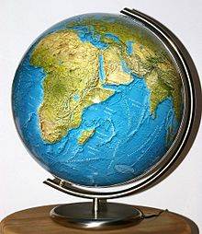
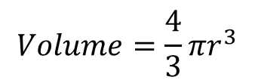


Volume and Surface Area of a Sphere
The Surface Area of a Sphere is given by this formula:
The Volume of a Sphere is given by the following formula:
$$Surface Area=4πr^{2}$$
r
Surface Area Demonstration
You will usually be given this formula on exams!
$$Volume=\frac{4πr^{3}}{3}$$
$$Volume=\frac{4}{3}πr^{3}$$
Volume of a sphere demonstration

Slide 3
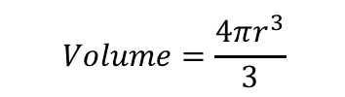




Volume and Surface Area of a Sphere
$$Volume=\frac{4πr^{3}}{3}$$
$$Surface Area=4πr^{2}$$
Find the Volume of a Sphere with a radius of 3.2m
$$Volume=\frac{4πr^{3}}{3}$$
Sub in the value of r
$$Volume=\frac{4×π×{3.2}^{3}}{3}$$
3.2m
Calculate
$$Volume=137.26cm^{3}$$

Slide 4
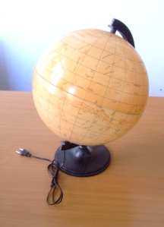
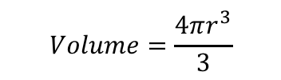



Volume and Surface Area of a Sphere
$$Volume=\frac{4πr^{3}}{3}$$
$$Surface Area=4πr^{2}$$
Find the Surface Area of a Sphere with a diameter of 6.5cm
$$Surface Area=4πr^{2}$$
Sub in the value of r
6.5cm
$$Surface Area=4×π×{3.25}^{2}$$
Calculate
Radius = 3,25cm
$$Surface Area=132.73cm^{2}$$

Slide 5

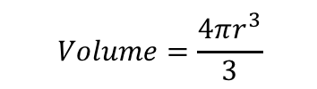



Volume and Surface Area of a Sphere
$$Volume=\frac{4πr^{3}}{3}$$
$$Surface Area=4πr^{2}$$
What is the Volume and Surface Area of this hemisphere?
$$Volume=\frac{4πr^{3}}{3}$$
Sub in r
$$Volume=\frac{4×π×{2.1}^{3}}{3}$$
Calculate
2.1cm
$$Volume=38.79cm^{3}$$
Divide by 2
$$Volume=19.40cm^{3}$$

Slide 6

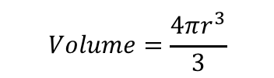







Volume and Surface Area of a Sphere
$$Volume=\frac{4πr^{3}}{3}$$
$$Surface Area=4πr^{2}$$
What is the Volume and Surface Area of this hemisphere?
$$Surface Area=4πr^{2}$$
Sub in r
$$Surface Area=4×π×{2.1}^{2}$$
Calculate
$$Surface Area=55.42cm^{2}$$
$$Surface Area=27.71cm^{2}$$
Divide by 2
2.1cm
Remember that the base is part of the surface area too!
$$Area of the base=πr^{2}$$
Sub in r
$$Total Surface Area=41.56cm^{2}$$
$$Area of the base=π×{2.1}^{2}$$
$$Area of the base=13.85cm^{2}$$
Calculate

Slide 7
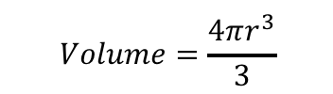
Volume and Surface Area of a Sphere
$$Volume=\frac{4πr^{3}}{3}$$
$$Surface Area=4πr^{2}$$
A tube of tennis balls is a cylinder with a radius of 3.8cm. It contains 3 balls which fit exactly inside it.
a) How high is the tube?
b) What is the Volume of the empty space in the Tube?

Slide 8
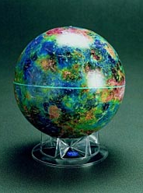
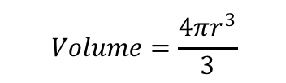
Volume and Surface Area of a Sphere
$$Volume=\frac{4πr^{3}}{3}$$
$$Surface Area=4πr^{2}$$
A tube of tennis balls is a cylinder with a radius of 3.8cm. It contains 3 balls which fit exactly inside it.
a) How high is the tube?
3.8cm
As the balls fit exactly, the radius of a ball must be 3.8cm
The diameter of a ball must be 7.6cm.
The tube is ‘3 balls’ in height
The tube is (3 x 7.6)cm high
22.8cm in height
7.6cm

Slide 9
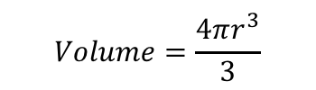
Volume and Surface Area of a Sphere
$$Volume=\frac{4πr^{3}}{3}$$
$$Surface Area=4πr^{2}$$
A tube of tennis balls is a cylinder with a radius of 3.8cm. It contains 3 balls which fit exactly inside it.
b) What is the Volume of the
empty space in the Tube?
→ Volume of the Cylinder – Volume of the balls
3.8cm
Volume of the Cylinder
Area of end x length
πr² x length
π x 3.8² x 22.8
= 1034.31cm³
Volume of the Balls
3 x Volume of 1 ball
3 x (⁴/₃πr³)
3 x (⁴/₃ x π x 3.8³)
= 689.54cm³
22.8cm
Area of the space = 344.77cm³

Slide 10
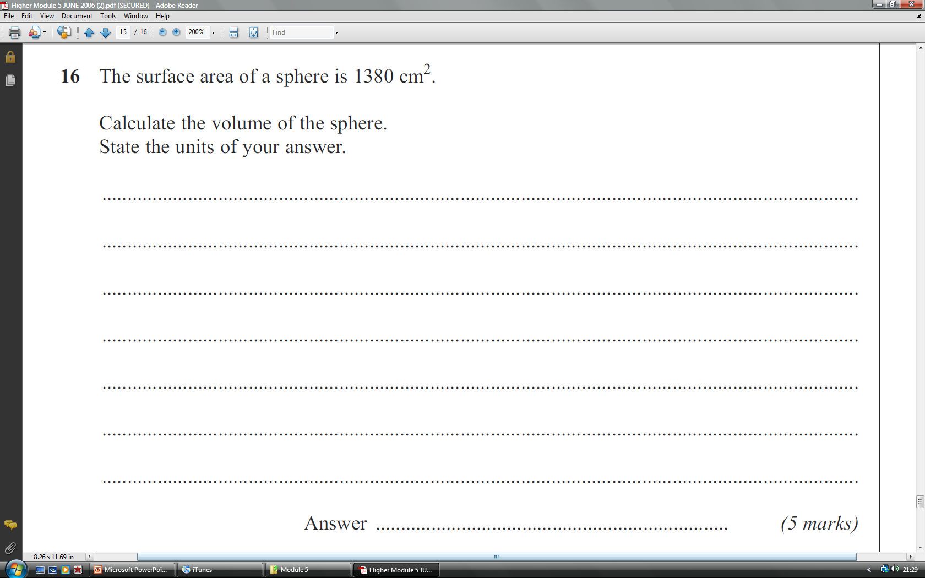
Plenary
4πr² = 1380
÷ 4π
r² = 109.82
√
r = 10.48
V = ⁴/₃πr³
V = ⁴/₃ x π x 10.48³
V = 4820.5cm³ (2dp)
4820.5cm³ (2dp)

Slide 11
Now complete number 5 on Page 40 of your MAWA Essentials Mathematics book.
Once you have completed that, try the worksheet.

